Slide 1

M.Sc. (IT) Object Oriented Programming with Python Project Title: Music Player
Group-12
Name | Roll No
Shreya Acharya | IT23B01
Diya Mandliya | IT23B23
1

Slide 2
Code
from tkinter import *
from tkinter import filedialog
from pygame import mixer
class MusicPlayer:
def __init__(self ,window):
window.geometry("320x100"); window.title("Music Player"); window.resizable(0,0)
Load = Button(window , text="Load" , width=10 ,font=("Times" ,10) ,command=self.load)
Play = Button(window , text="Play" , width=10 ,font=("Times" ,10) ,command=self.play)
Pause = Button(window , text="Pause" , width=10 ,font=("Times" ,10) ,command=self.pause)
Stop = Button(window , text="Stop" , width=10 ,font=("Times" ,10) ,command=self.stop)
Load.place(x=0 , y=20) ; Play.place(x=110 , y=20) ; Pause.place(x=220 , y=20) ;Stop.place(x=110 , y=60)
self.music_file = False
self.playing_state = False
2

Slide 3
Code
def load(self):
self.music_file = filedialog.askopenfilename()
def play(self):
if self.music_file:
mixer.init()
mixer.music.load(self.music_file)
mixer.music.play()
def pause(self):
if not self.playing_state:
mixer.music.pause()
self.playing_state = True
else:
mixer.music.unpause()
self.playing_state = False
def stop(self):
mixer.music.stop()
root = Tk()
app = MusicPlayer(root)
root.mainloop()
3

Slide 4
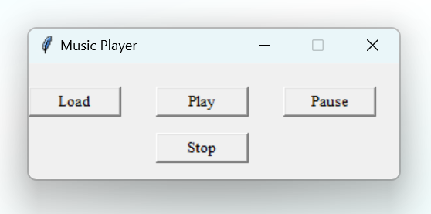
Output

Slide 5
Thank You…

